Slide 1
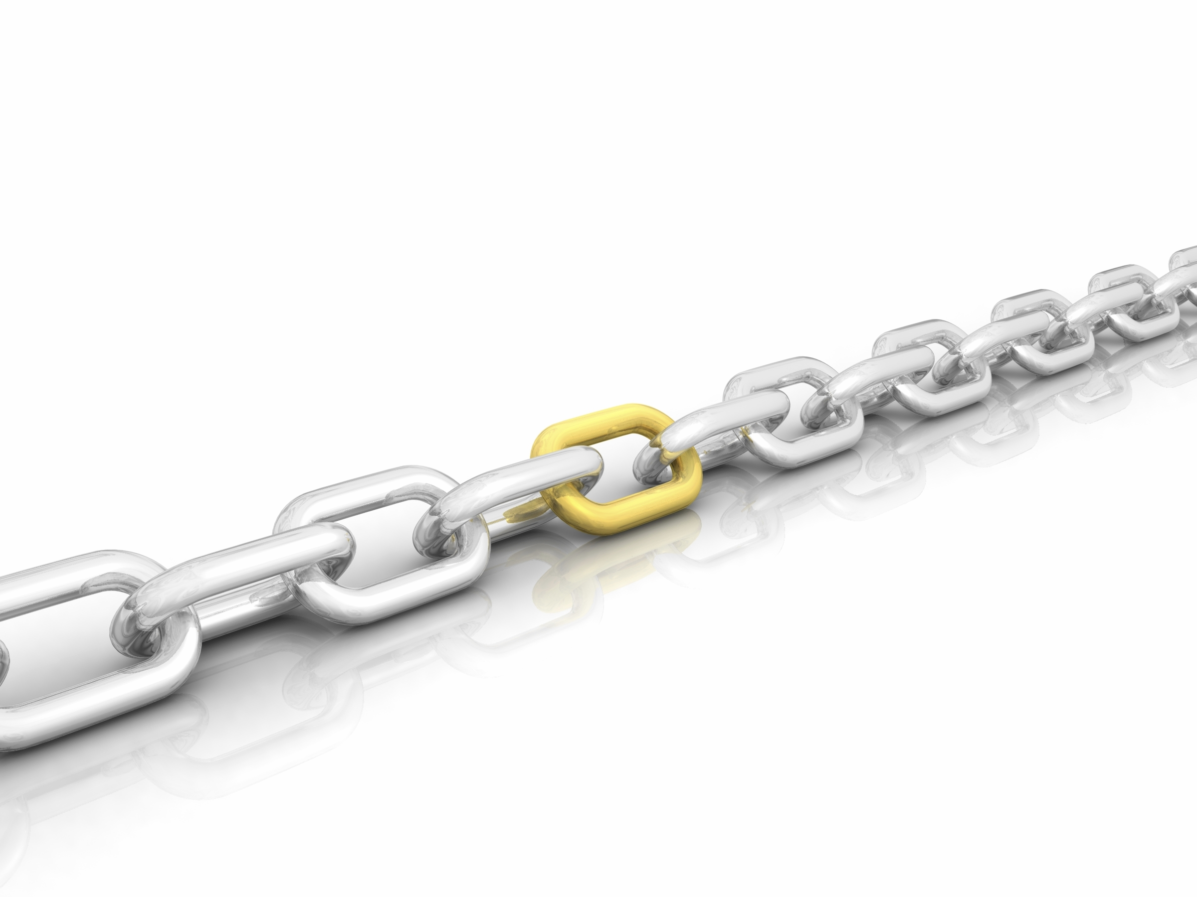

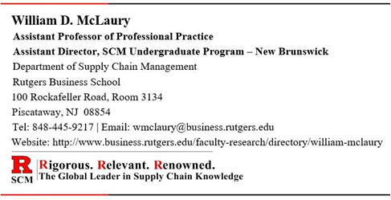
Supply Chain
Management
Logistics:
Warehousing, Transportation, & Reverse Logistics
William McLaury
Associate Professor of Professional Practice
Director, SCM Undergraduate Program – New Brunswick
Department of Supply Chain Management
Rutgers Business School
100 Rockafeller Road, Rm. 3134, Piscataway, NJ 08854
Tel: 848-445-9217 | Email: wmclaury@business.rutgers.edu
Website: http://www.business.rutgers.edu/faculty/william-mclaury

Slide 2
Video Introduction
“Move It” - Transportation and Logistics
3:15 minutes

Slide 3
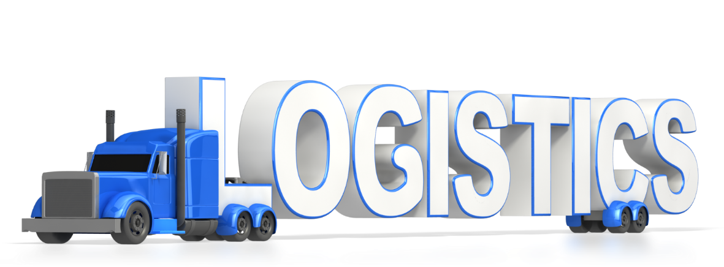
Introduction
Logistics is:
“…that part of supply chain management that plans, implements, and controls the efficient, effective flow and storage of goods, services, and related information, from the point of origin to point of consumption, in order to meet customer requirements.”
Council of Supply Chain Management Professionals
Discussion Outline
Warehousing
Transportation
Reverse Logistics

Slide 4
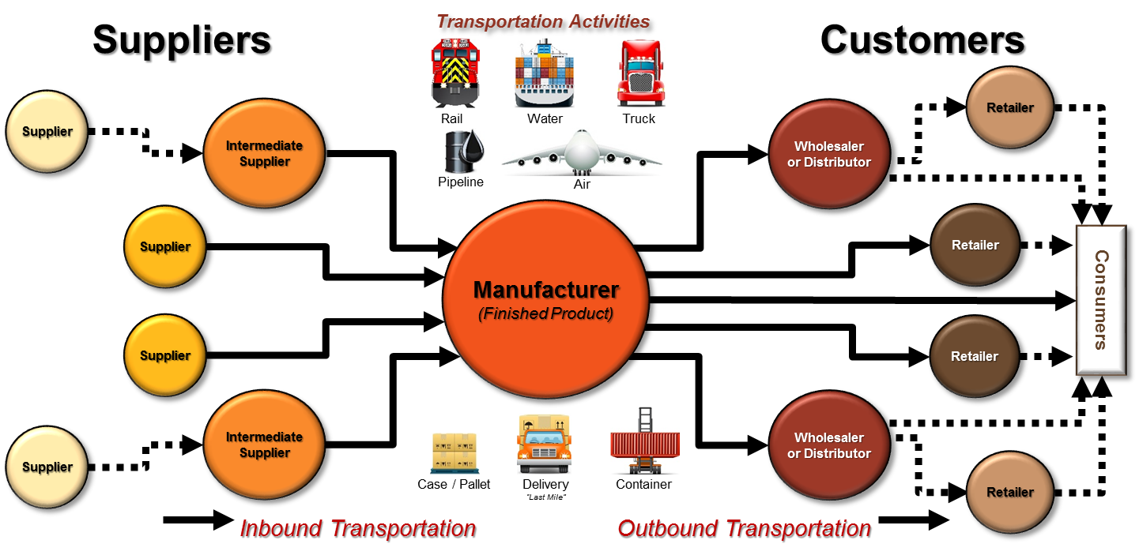
Introduction (continued)
Logistics is necessary to:
Move goods and materials from suppliers to buyers
Move goods and materials between sites (internal and external)
Move finished goods to the customer
Inbound Logistics
Material Handling
Outbound Logistics
Products have little value to the customer until they are moved to the customer’s point of consumption
Delivered at the right time.
Delivered to the desired location.
Customers can be
internal or external

Slide 5
Supply Chain
Management
Warehousing
The true value of warehousing lies in having the right product in the right place at the right time. Warehousing provides time and place utility; the availability necessary to give materials true value.

Slide 6
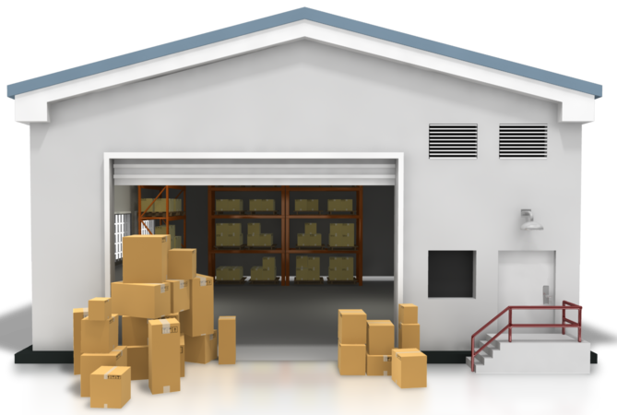
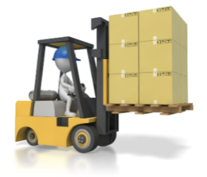
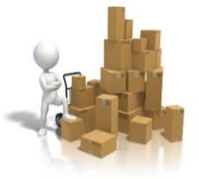
Warehousing
Warehouse: Facility used to store purchases, work-in-process (WIP), and finished goods inventory.
Warehousing: Function that allows a company to receive, store, breakdown, repackage, and distribute items to a manufacturing location, or finished products to a customer
Decisions driving Warehouse Management include:
Number of warehouse facilities in the network
Site selection
Layout of the warehouse(s)
Methods of receiving, storing, retrieving, and distributing products and materials.
Examples:
Manual
Semi-Automated
Fully Automated

Slide 7
Primary Functions of a Warehouse
Receiving: Physical receipt of material, identification, inspection for conformance with the purchase order (quantity and damage), put-away, and preparation of receiving reports
Storage: The safe and secure retention of parts or products for future use or shipment.
Picking: Withdrawing components from stock to make assemblies or finished goods, or to ship to a customer.
Packing: Placing one or more items of an order into an appropriate container for safe shipping , and marking and labeling the container with customer shipping destination data, and other information that may be required.
Shipping: Outgoing shipment of parts, components, and products. Includes packaging, marking, weighing, and loading for shipment. [Does NOT include Transportation]

Slide 8
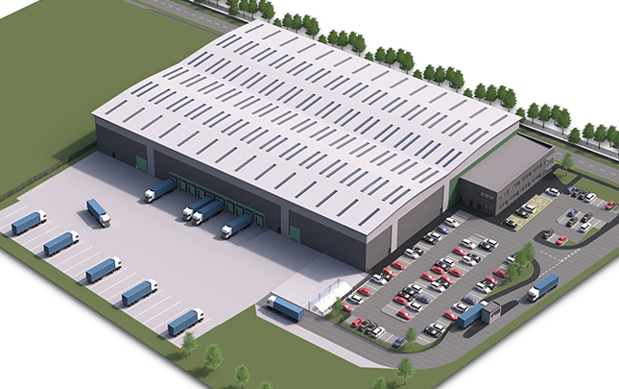
Secondary Functions of a Warehouse
Quality Inspections - incoming and outgoing.
Repackaging – for specific customer orders.
Assembly Operation – Warehouse operation that puts products together with other items/components before shipping them out to the final customer. Examples:
Literature
Spare Parts
Advertising Materials

Slide 9
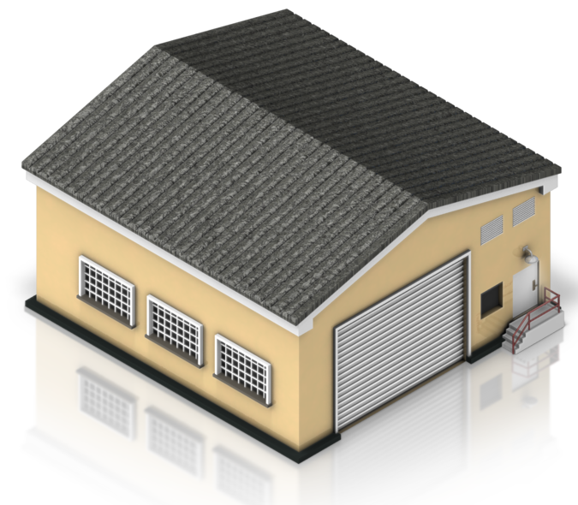
Warehouse Ownership
Ownership Types:
Public Warehouses
Contract Warehouses
Private Warehouses

Slide 10
Types of Ownership: Public Warehouse
A business that provides storage and related warehouse functions to companies on a short or long-term basis, generally on a month-to-month basis for a fee.
Own their own equipment and hire their own staff to manage the facility.
Fees are typically a combination of a monthly storage fee plus a pallet-in fee and a pallet-out fee.
Fees will vary based on what is being stored and/or based on:
Size and weight of the pallets
If they can be stacked
How fragile the product is
Value of goods (risk of theft)
Hazards associated with the goods
They may also have some document fees and account management fees.
Think of it as a hotel for inventory

Slide 11
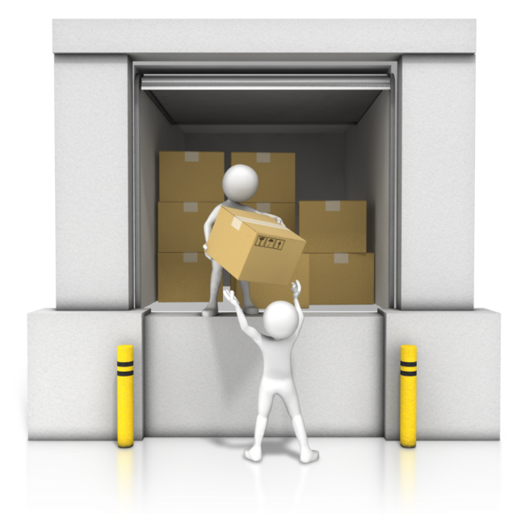
Types of Ownership: Public Warehouse
Advantages:
No capital investment or property taxes
Flexibility:
Can be short or long term contract
For seasonal products
Add storage capacity even on short notice
Lower costs and reduced risk
Access to special features and services:
Temperature-controlled storage
Customer Service, Inventory Ordering, etc.
Office space for customer’s sales, accounting, etc.
Disadvantages:
Potential for incompatible computer systems
Specialized services may not be what is required/needed
Space may not be available when/where needed

Slide 12
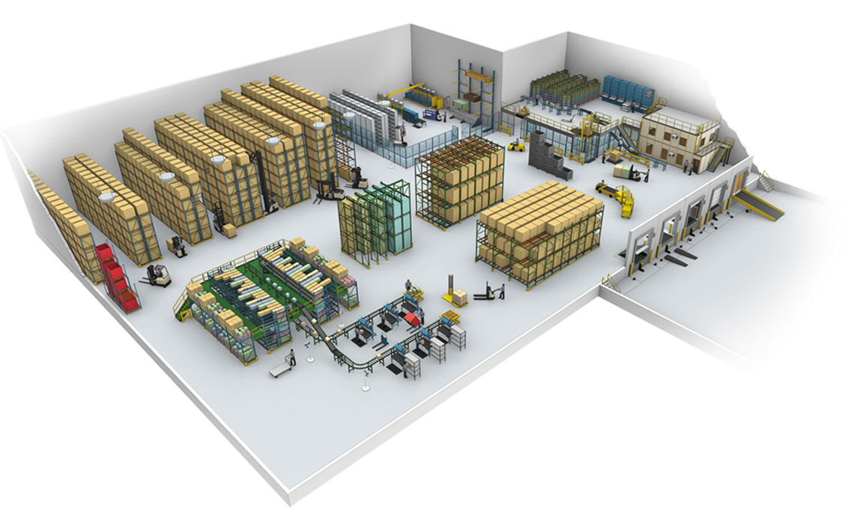
Types of Ownership: Contract Warehouse
A variation of public warehousing that handles the shipping, receiving, and storage of goods on a contract basis for a fee.
The contract can be for an entire building, or for a defined portion within a building.
Think of it as renting an apartment for inventory
Usually requires a client to commit to services for years rather than months
The fee structure may be fixed cost, cost-plus, or a combination of both.
The company providing the space handles the employees, equipment, and maintenance.

Slide 13
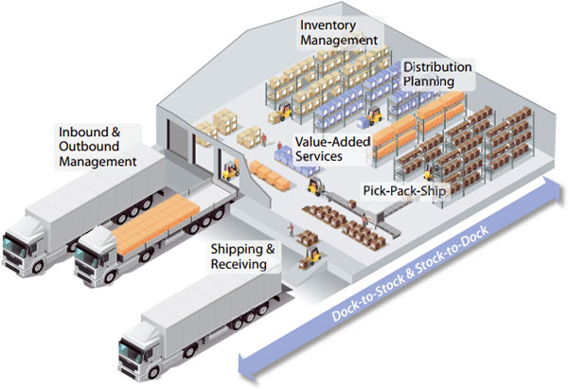
Types of Ownership: Contract Warehouse
Many of the advantages and disadvantages of a public warehouse also apply to contract warehousing.
Advantages:
Services: client can obtain specialized services tailor-made to suit their needs.
Cost: can be bundled in the contract and negotiated at a lower cost.
Control: contract warehousing offers a degree of control at a reasonable price
Disadvantages:
Duration: The client company is expected to enter into a contract for a specific period of time; generally three years.

Slide 14

Types of Ownership: Private Warehouse
A storage facility that is owned by the company that owns the goods being stored in the facility.
Generally established by companies that have a large volume or highly valuable goods, or the need for some type of specialized storage or handling.
Can be operated as a separate division within a company
Can be co-located on-site with manufacturing, or off-site.
Think of it as buying a house for inventory

Slide 15
Types of Ownership: Private Warehouse
Advantages:
Control: Offers greater flexibility in designing the warehouse and gives users significant control over operations.
Visibility: inventory, material flow, handling, supervision, and associated costs.
Cost: Operating cost can be 15% - 25% lower if the company achieves at least 75% utilization.
Disadvantages:
High Start-up Cost: Capital to build or buy a warehouse. Long, risky investment. Cost of hiring and training employees. Purchase of material handling equipment.
Fixed Location: Not easy to move to another location if the market changes.
Fixed Size and Costs: When volume is low, the company still assumes the fixed costs.

Slide 16
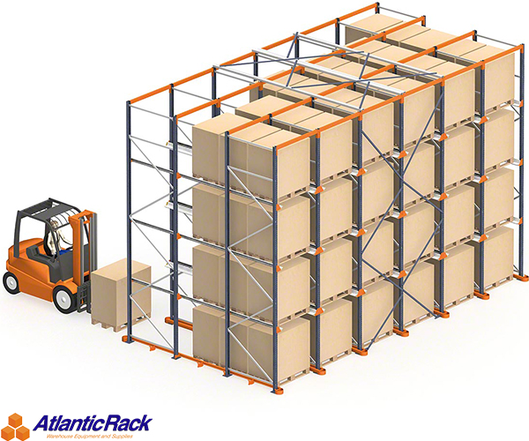
Types of Warehouses
Types:
Consolidation
Break-Bulk
Cross-Docking

Slide 17
Consolidation Warehouse
Warehouse operation that receives products from different plants or suppliers, stores them, and then combines them with similar shipments from other plants or suppliers for further distribution.
Less-Than-Truckload
(LTL) Shipments
Plant or
Supplier A
Cost per unit = High
Full Truckload
(FTL) Shipment
Cost per unit = Low
Consolidation
Warehouse
Plant or
Supplier B
Customer
Plant or
Supplier C
Located closer to the supply base so that smaller LTL shipments travel shorter distance and can be consolidated into larger FTL shipments traveling longer distance to the customer.

Slide 18
Break-Bulk Warehouse
Warehouse operation that divides full truckloads of items from a single source or manufacturer into smaller, more appropriate quantities for use or further distribution.
Less-Than-Truckload
(LTL) Shipments
Cost per unit = High
Customer
#1
Full Truckload
(FTL) Shipment
Cost per unit = Low
Break-Bulk
Warehouse
Plant or Supplier
A
Customer
#2
Located closer to the customer base so that the smaller LTL shipments travel the shorter distance, while the larger FTL shipments from the single source travel the longer distance before arriving at the break-bulk warehouse.
Customer
#3

Slide 19
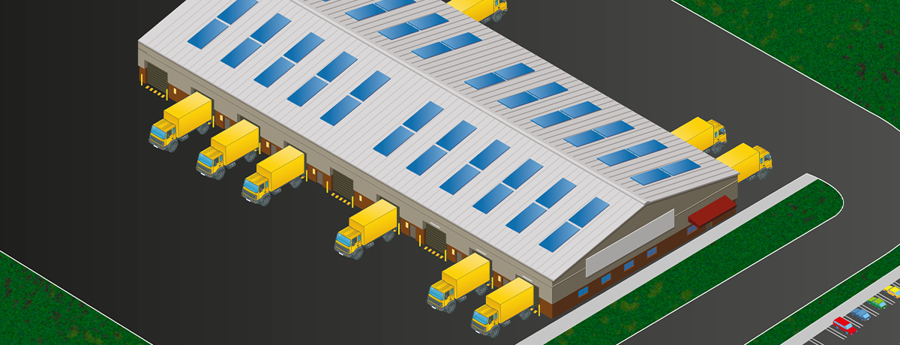
Cross-Docking Warehouse
The logistics practice of unloading materials from an incoming truck or railcar and loading these materials directly onto outbound trucks or railcars, with little or no storage in between to reduce inventory investment and storage space requirements.
The main reasons that cross docking is implemented is to:
Provide a central site for products to be sorted and combined for delivery to multiple destinations in the most productive and fastest method possible.
Consolidate: Combine smaller product loads into one method of transport to save on transportation costs.
Break-Bulk: Break down large product loads into smaller loads for transportation for an easier delivery process to the customer.

Slide 20
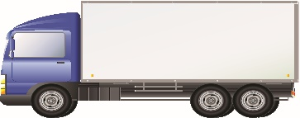
Cross-Docking Warehouse
Sorting
Area
A
A
A
A
A
Movement Across the Dock
A
A
B
C
D
A
A
A
A
A
A
B
B
C
D
B
B
B
B
B
A
B
B
D
D
B
B
B
B
B
A
C
C
D
D
Suppliers
Inbound Receiving
Outbound Shipping
Customers
C
C
C
C
C
A
A
B
C
D
C
C
C
C
C
A
A
B
C
D
D
D
D
D
D
Movement Across the Dock
B
B
B
D
D
D
D
D
D
D
A
A
A
C
C
Note: Suppliers and Customers can be internal or external

Slide 21
Cross-Docking Warehouse
Without Cross-Docking
With Cross-Docking
Supplier
Supplier
Supplier
Supplier
Supplier
Supplier
Supplier
Supplier
Cross Docking Warehouse
Customer
Customer
Customer
Customer
Customer
Customer
Customer
Customer
16 LTL Shipments
8 FTL Shipments
4 shipments for each supplier
4 shipments for each customer
1 shipment for each supplier
1 shipment for each customer
Advantages:
Transportation Cost Savings: 8 FTL Shipments are less expensive per unit than 16 LTL Shipments.
Operational Efficiency: Warehouse operations are more efficient as the material does not have to be stored at the warehouse, moving directly from receiving to shipping.
Inventory Efficiency: As there is no storage at the warehouses, total inventory in the supply chain can be reduced.

Slide 22
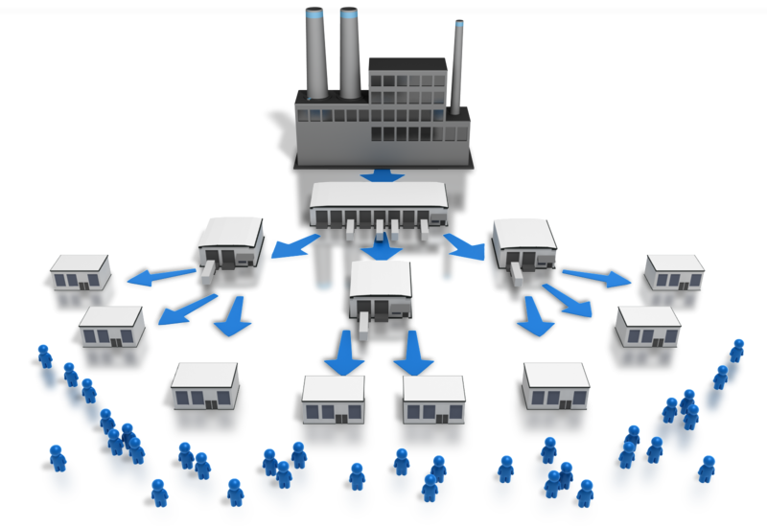
Warehouse Network
A warehouse network is simply the number of, and the relationship between, the warehouses that a company has in their organizational structure.
The fundamental questions to be answered in establishing a warehouse network are:
How many warehouses are needed?
Where should they be located?
Trade-offs that will determine how many warehouses the company needs and where they should be located are:
The level of customer service the company wants to provide
The greater the desired custom service level – the more warehouses the company may need to geographically disperse inventory.
The amount of inventory the company is willing to invest in
The more warehouses the company needs – the greater the amount of inventory the company will need to invest.

Slide 23
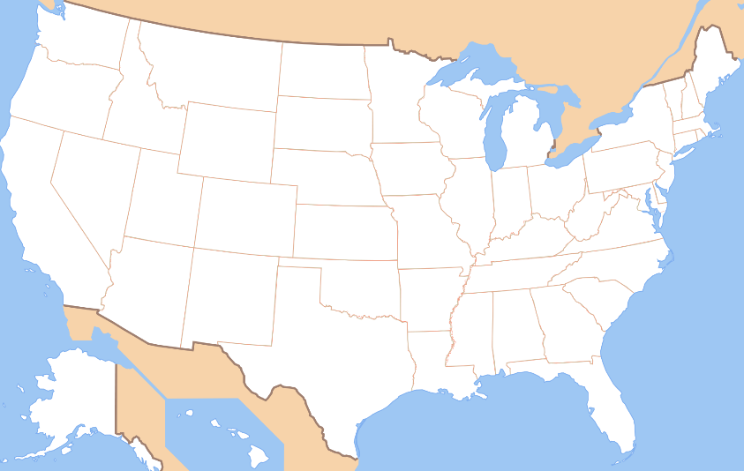
Warehouse Network: Single Warehouse
Positives:
Less complicated
Operating costs and inventory will be lower
No duplication of equipment, warehouse staff, and managers
■
Network will be centralized and the company will have its best people, equipment and inventory systems concentrated in one place.
Warehouse can more actively focus on the needs of its customers.
Negatives:
The single warehouse (i.e., centralized network) may take longer to deliver product to some customers who are remote from the central location.

Slide 24
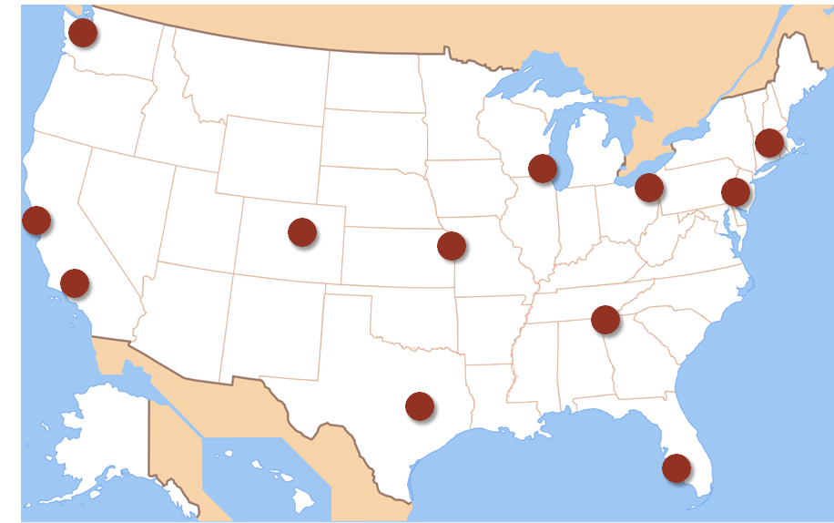
Warehouse Network : Multiple Warehouses
Positives:
Potentially faster delivery to customers from a decentralized network that is geographically dispersed throughout the market, assuming adequate inventory in each warehouse
Negatives:
More complicated
Operating costs and inventory will be higher as each warehouse costs money to staff and operate. Duplication of equipment, warehouse staff, and managers
Network will be decentralized and the company will have to spread its best people, equipment and inventory systems across a larger network.

Slide 25
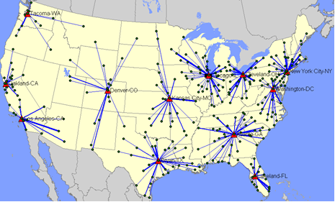
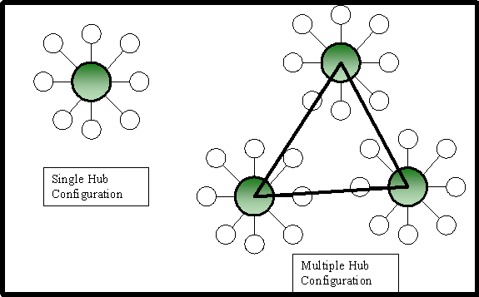
Warehouse Network : Hybrid Approach
One hybrid network is a “hub-and-spoke” where there is a centralized warehouse (i.e., the “hub”) which holds most of the inventory linked to a series of smaller geographically dispersed warehouses (i.e., the “spokes”) which hold only a small amount of inventory to support their local area in the immediate time frame
The hub warehouse feeds the spoke warehouses with inventory as necessary on a regular basis.
Operating costs are lower because the spoke warehouses are smaller than in a purely decentralized model.
Inventory is also lower as all of the safety stock is held centrally, which generally means that less total safety stock is required because all of the risk and uncertainty is managed centrally.
Customer service is generally better than in a purely centralized model since some of the inventory is maintained closer to the customer.

Slide 26
Warehouse Network Strategy
Whether a company determines that it needs one or multiple warehouses, it will also have to determine which location strategy makes the most sense for its business.
The strategy decision will be different from one business to another, depending on the nature of the business and how many customers and suppliers the company has.
The 3 main warehouse network location strategies are:
Market Positioned Strategy
Product Positioned Strategy
Intermediately Positioned Strategy

Slide 27
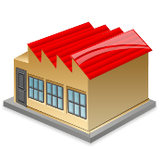
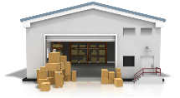
Market Positioned Strategy
Warehouses are set up close to customers to maximize distribution services and improve delivery.
Companies use this strategy when they have many more customers than suppliers, and the customers are spread out geographically around the market.
If the warehouses are closer to the customers the company can minimize transportation cost.
There will likely be FTL shipments coming in from suppliers from greater distances, and LTL shipments going out to customers from shorter distances.
Customer
Customer
Customer
Warehouse
Customer
Customer
Few suppliers; Many customers

Slide 28
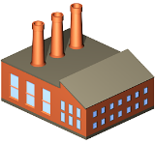
Product Positioned Strategy
Warehouses are set up close to supply sources to collect goods and consolidate before shipping products out to customers.
This is the reverse of the market positioned strategy.
Companies use this strategy when they have many more suppliers than customers.
If the warehouses are closer to the suppliers the company can minimize transportation cost.
There will likely be LTL shipments coming in from suppliers from shorter distances, and consolidated FTL shipments going out to customers from longer distances.
Supplier
Supplier
Supplier
Warehouse
Supplier
Supplier
Many suppliers; Few customers

Slide 29
Intermediately Positioned Strategy
Warehouses are set up somewhere midway between the supply sources and the customers to try to balance costs, inventory and customer service.
This strategy is used when distribution requirements are high and product comes from various supply locations.
A warehouse network optimization study may be needed to determine the optimal number and location of warehouse in this strategy.
SUPPLIER
SUPPLIER
customer
warehouse
SUPPLIER
customer
Equal number of suppliers and customers

Slide 30
Warehouse Network Optimization
Companies need to find the balance that will work for their products and markets.
There are many consulting companies that offer services to help a company determine their optimal number of warehouses and locations by using a number of different optimization software programs.
The software analyzes the inputs including customer and manufacture locations, and then informs the optimal numbers of warehouses and locations based on all the factors.
These programs try to minimize the amount of transportation on both ends, inbound from your suppliers and outbound to your customers.

Slide 31
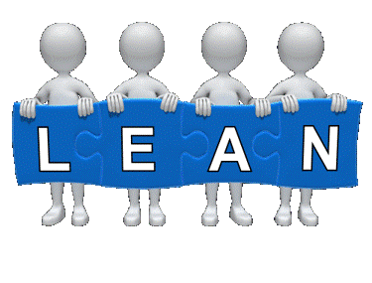
LEAN Warehousing
Warehouses and distribution centers are continuing to develop their LEAN capabilities:
Cross Docking - A LEAN concept because it eliminates the need to store inventory, and reduces some transportation, which are both wastes.
Reduced Lot Sizes and Shipping Quantities - By reducing lot sizes and shipping quantities, a company can increase velocity in the warehouse, and get shipments out faster. Faster throughput is a LEAN concept.
Increased Automation - Companies are using automated systems like pick to light, voice picking, conveyor systems, automatized guided vehicles (AGV’s), and robotics to improve efficiencies and throughput times in the warehouse.
Green Warehousing - One of the more sustainable goals for a green warehouse is to make it a net zero energy user.

Slide 32
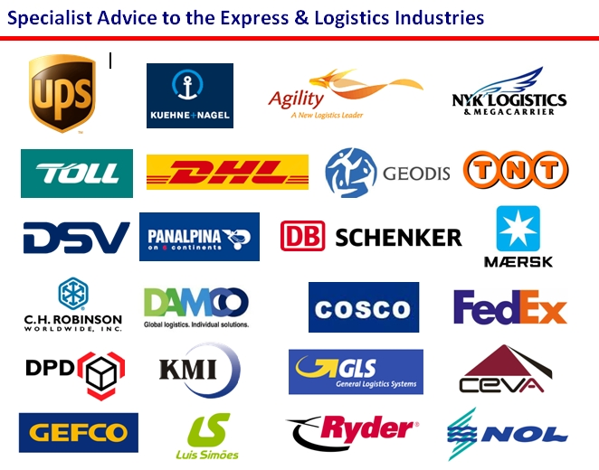
Third Party Logistics (3PL)
A Third Party Logistics (3PL) company is an outsourced provider that manages all, or a significant part, of an organization’s logistics requirements for a fee.
3PL providers charge a fee for their services.
They typically generate a 10 to 20% savings in logistics costs.
Favored by small businesses
Used to a significant degree for international logistics

Slide 33
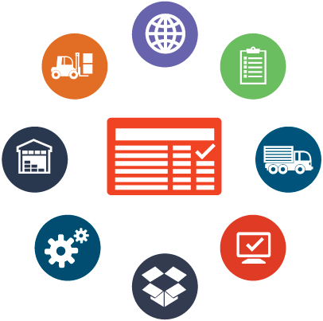
Third Party Logistics Services
Typical services offered by 3PL’s include:
Inbound Transportation
Outbound Transportation
Warehousing
Pick and Pack
Freight Forwarding
Customs Brokerage
Customs Clearance
Order Taking
Billing and Invoicing
Inventory Auditing
Freight Bill Auditing and Payment
Third Party Logistics

Slide 34
Third Party Logistics – Advantages & Disadvantages
Advantages of Using a 3PL:
Cost: Eliminates the need for a company to invest in warehouse space, technology, and staff to execute the logistics process.
Logistics Expertise: Knowledgeable of industry best practices and the latest developments in technology.
Efficiency: 3PL’s can leverage relationships and volume discounts, which result in lower overhead and the fastest possible service.
Disadvantages of Using a 3PL:
Control: A company will not have direct control over the logistics operation.
Dependency: Outsourcing logistics creates a dependency on the 3PL.
Pricing: The company is locked into the pricing model specified in the contract

Slide 35
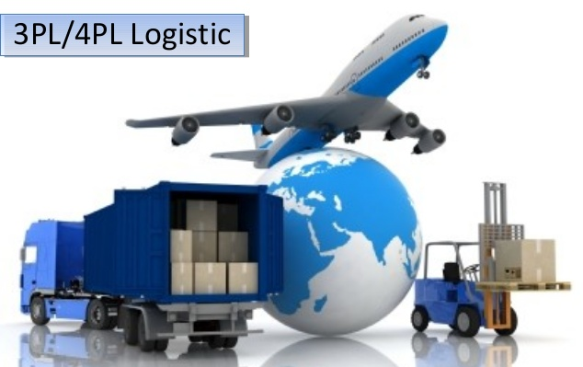
Fourth Party Logistics (4PL)
Fourth-party logistics (4PL) is an interface between the client company and multiple logistics service providers.
A company will select a lead logistics partner (referred to as a 4PL) that is then charged with managing the activities of all the other 3PL’s being used by the company.
Ideally, all aspects of the client company’s supply chain handled by 3PL’s would be managed by the 4PL organization.

Slide 36
Supply Chain
Management
Transportation

Slide 37
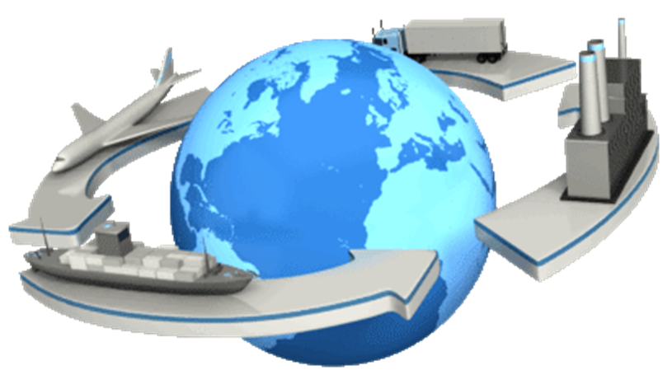
Transportation
The function of planning, scheduling, and controlling activities related to the mode, carrier, and movement of inventories into and out of an organization.
Get the right product, to the right place, at the right time by ensuring the product is moved as efficiently as possible from point-of-origin to point-of-destination.
(APICS Dictionary)
Objectives of Transportation:
To maximize the value to the company through price negotiations
To make sure service is provided effectively
To satisfy customers’ needs

Slide 38
Transportation Company Classifications
Contract Carriers
Person or company who transports freight under contract to one or a limited number of shippers.
Private Carriers
person or company that transports its own cargo as a part of a business that produces, uses, sells or buys the cargo that is being hauled.
Common Carriers
Person or company who transports freight for a fee that can be hired by anyone to transport goods.
Exempt Carriers
Person or company specializing in services or transporting commodities exempt from regulation by the Interstate Commerce Act.

Slide 39
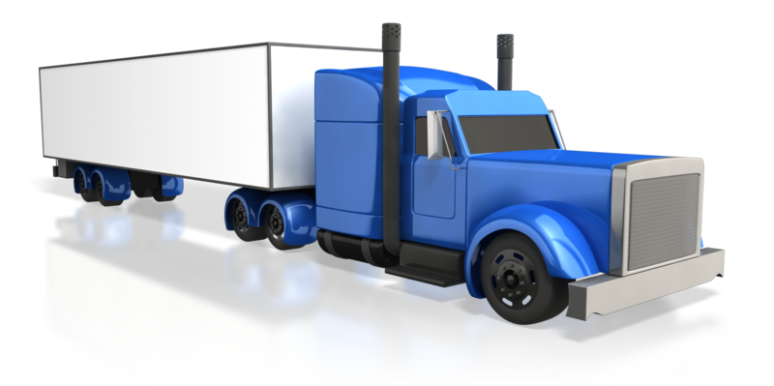
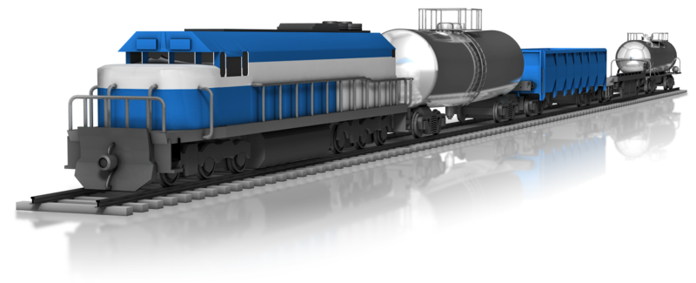
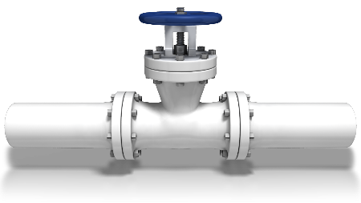
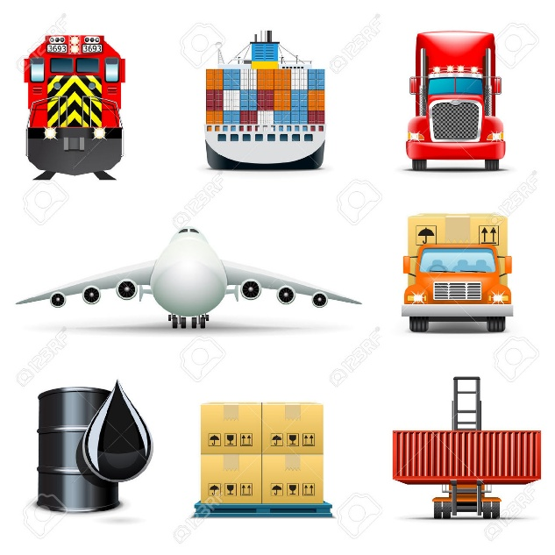
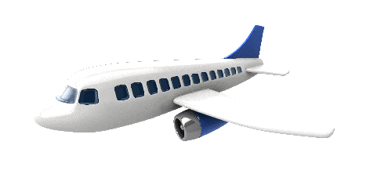
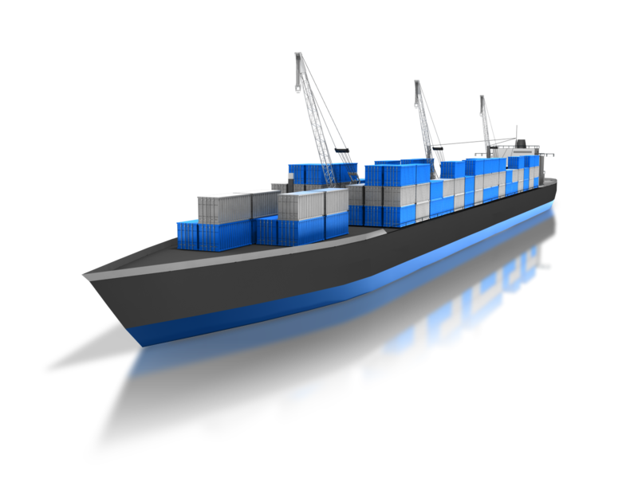
Modes of Transportation
“Mode” refers to the way in which goods are transported
“Carrier” refers to the company that transports the goods
Rail
Truck
Pipeline
Air
Water

Slide 40

Modes of Transportation - Truck
Most flexible mode of transportation
Carries > 80% of U.S. Freight
Because of interaction with other transportation modes to and from ports & warehouses
Carries nearly anything from packaged household goods, to building materials, to liquid petroleum, etc.
Competes with Rail and Air for short-to-medium hauls.
Short Haul = 0 - 200 miles from the driver's home terminal
Long Haul = over 200 miles from the driver’s home terminal
Impacted by the truck driver shortage and Hour-of-Service rules

Slide 41
Modes of Transportation – Truck (continued)
General Freight Carriers - A trucking company which handles a wide variety of commodities in standard trailers. Freight is generally palletized.
These can be LTL or FTL carriers. [see next slide for definition]
They carry the majority of goods shipped.
Does not require the use of specialized equipment.
Specialized Carriers - A trucking company which handles the movement of cargo that requires specialized equipment for transportation because of the shipment's size, weight and shape.
Transport commodities like liquids, petroleum, household goods, building materials, and other specialized items.

Slide 42
Modes of Transportation – Truck (continued)
Less-Than-Truckload (LTL) is the transportation of relatively small freight, i.e., the freight does not require the entire space of a truck.
Advantages: Can be cost effective. There are more available carrier options. Ideal for small businesses.
Disadvantages: Increased risk of theft/damage. Increased shipping times and delays.
Full-Truckload (FTL) is the transport of goods that fill up a full truck, or a partial load shipment occupying an entire truck.
Advantages: Best way to transport large shipments. Ideal for high risk or delicate freight shipments. Considerably faster than LTL.
Disadvantages: Costs more than LTL.

Slide 43
Modes of Transportation - Rail
Accounts for approximately 9% of total US freight spend.
Competes for transportation when the distance is long and the shipments are heavy or bulky.
Shipments involve building materials, construction equipment, coal, gravel, sand, lumber, etc.
Aging infrastructure and equipment are an issue.
Rail is slow and inflexible but it has the most capability
Paired with trucks for door-to-door delivery.
As a result, rail carriers have begun purchasing motor carriers and can now offer point-to-point pickup and delivery service.

Slide 44
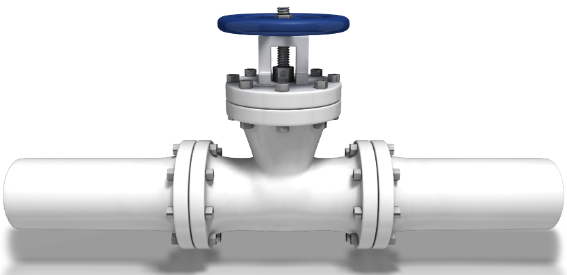
Modes of Transportation - Pipeline
Accounts for approximately 2% of total US freight spend
Most reliable form of transportation
Lowest per unit cost for transportation
Limited variety of commodities.
Materials are transported in a liquid or gaseous state; petroleum, natural gas, drinking water, gasoline
Little maintenance needed once the pipeline is running.

Slide 45
Modes of Transportation - Air
Accounts for approximately 5% of total US freight spend
Generally the fastest mode of transportation.
Most expensive mode of transportation
Cannot carry extremely heavy or bulky cargo. Ideally, items with a high cost to weight ratio.
Shipments involve very light, high-value goods that need to travel long distances quickly including; jewelry, fine wines, pharmaceuticals, racehorses, etc.
Half of the goods transported by air are carried by freight–only airlines, e.g., FedEx. Other half in passenger planes with luggage
Paired with trucks for door-to-door delivery

Slide 46
Modes of Transportation - Water
Accounts for approximately 5% of total US freight spend
Includes inland waterways, coastal and intracostal, and deep-sea cargo shipments.
Inexpensive
Very slow and inflexible.
Primarily used for heavy, bulky, low value materials like coal, grain, sand, and petroleum.
However, because transport by water is so cheap almost any item may be shipped by water including: automobiles, produce, containerized cargo, etc.
Competes with rail and pipeline for some cargo shipments.
Paired with trucks for door-to-door delivery.

Slide 47
Ranking of Transportation Modes
1 to 5 = Best to Worst
 | Accessibility | Capability (can handle the most kinds of freight, i.e., weight, size, type, etc.) | Lowest Per-unit Cost | Reliability | Speed | Total
Truck | 1 | 2 | 4 | 2 | 2 | 11
Rail | 2 | 1 | 3 | 3 | 3 | 12
Pipeline | 5 | 5 | 1 | 1 | 4 | 16
Air | 3 | 4 | 5 | 4 | 1 | 17
Water | 4 | 3 | 2 | 5 | 5 | 19

Slide 48
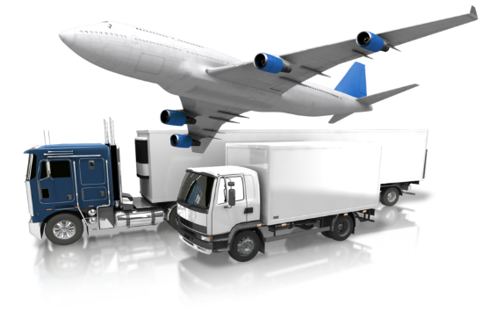
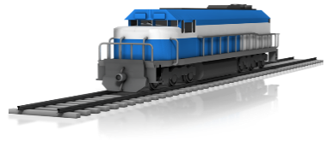
Intermodal Transportation
Intermodal is sometimes referred to as the sixth mode of transportation, but it is really the use of multiple modes of transportation to execute a single transport shipment.
Intermodal is growing substantially because it is fairly cost-efficient and cost-effective.
The most common forms of intermodal transportation involve:
Rail and Motor Carriers (i.e., trucks)
Rail and Water Carriers
Roll-on/Roll-off Ships

Slide 49
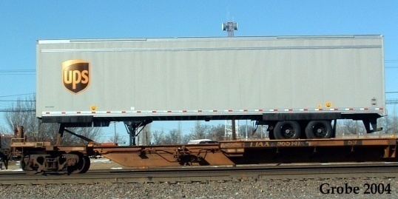
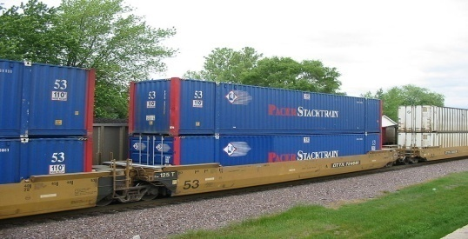
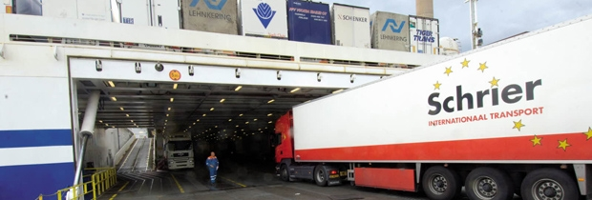
Intermodal Transportation (continued)
aka “Piggy-back” service
Rail and Motor Carriers (trucks)
Offer point-to-point pickup and delivery service known as Trailer-on-Flatcar (TOFC)
Rail and Water Carriers
Offer point-to-point pickup and delivery service known as Container-on-Flatcar (COFC)
Roll-On/Roll-Off Ship
specifically designed to allow trucks to be driven directly on and off the ship without the use of cranes.
Provides flexibility and speed

Slide 50
Transportation Regulation
[1870 to 1970]
Period of Regulation
Granger laws (1870s) - regulated the Railroads
Interstate Commerce Act of 1887 - created the Interstate Commerce Commission (ICC).
Transportation Act of 1920 - changes to Interstate Commerce Act
Motor Carrier Act of 1935 - brought motor carriers under Interstate Commerce Commission control.
Transportation Act of 1940 - established Interstate Commerce Commission control over domestic water transportation.
Federal Aviation Act of 1958 - created air traffic and safety regulations and the national airport system.
Department of Transportation Act of 1966 - coordination of all transportation-related matters.
Note: Only need to know Interstate Commerce Act

Slide 51
Transportation Deregulation
[1970 to Today]
Period of Deregulation
Railroad Revitalization and Regulatory Reform Act (1976)
Railroads could change rates without ICC approval
Air freight deregulated in 1977
Motor carriers deregulated in 1980
Promote competitive, safe and efficient motor transportation
Shipping Act of 1984
Allowed ocean carriers to pool shipments, assign ports, publish rates, and enter into contracts with shippers
ICC Termination Act of 1995
The Interstate Commerce Commission (ICC) was eliminated
Ocean Shipping Reform Act of 1998
Requirement for ocean carriers to file rates ended
Note: Only need to Know ICC Termination Act

Slide 52

Regulation Pro’s and Con’s -vs- Deregulation
Regulation Pro’s:
Tends to assure adequate transportation service throughout the country.
Protects consumers from monopoly pricing, safety, and liability.
Regulation Con’s:
Discourages competition
Does not allow prices to adjust based on demand or by negotiation.
Deregulation encourages competition and allows prices to adjust as demand and negotiations dictate.
U.S. transportation industry remains mostly deregulated

Slide 53
Transportation Pricing
Since deregulation, negotiating prices is common
Cost of Service Pricing - is the setting of a price for a service based on the costs incurred in providing it.
Value of Service Pricing - is a pricing strategy which sets prices based on the value perceived by the customer, i.e., “priced at what the market will bear”.
Combination Pricing - price is set at a value between cost-of-service minimum and value-of-service maximum. Most carriers use some form of combination pricing. Common in highly volatile markets and changing competitive situations
Net-Rate Pricing - Established discounts and accessorial charges are rolled into one all-inclusive price. Pricing is tailored to the individual customer’s needs

Slide 54
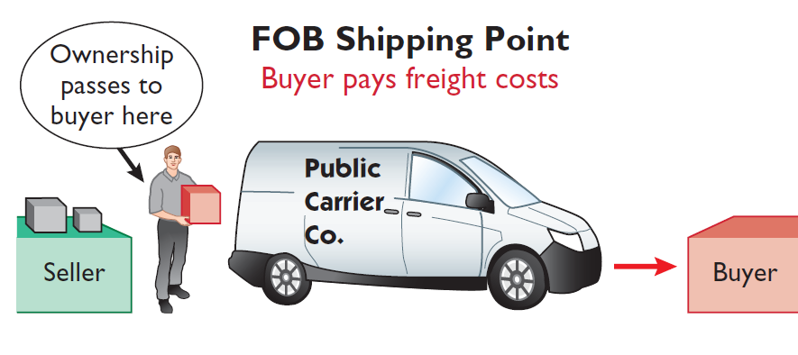
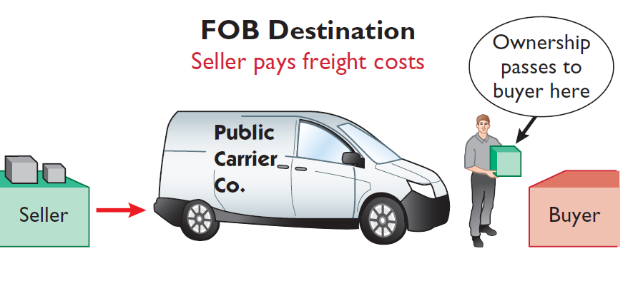
Delivery and payment terms agreed between a buyer and a seller.
Freight: Terms of Sale =
Free on Board (F.O.B.) Origin
Seller places goods Free On Board with the carrier at the seller’s location, and buyer pays freight costs.
Ownership of the goods passes to the buyer when the public carrier accepts the goods from the seller.
Buyer assumes the risk for in-transit loss or damage
Free on Board (F.O.B.) Destination
Seller places goods Free On Board to the buyer’s place of business, and the seller pays freight costs.
Ownership of the goods remains with the seller until the goods reach the buyer.
Seller assumes the risk for in-transit loss or damage.

Slide 55
Other Transportation Intermediaries
Freight Forwarder - Consolidates LTL shipments into FTL shipments.
They take small shipments from multiple companies and consolidate them into larger shipments.
Load or Transportation Broker - Bring shippers and carriers together
Shippers’ Association - Nonprofit cooperatives which arrange for members’ shipping
Intermodal Marketing Company - Purchase blocks of rail capacity and sell it to shippers

Slide 56
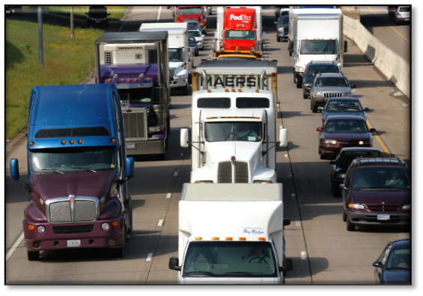
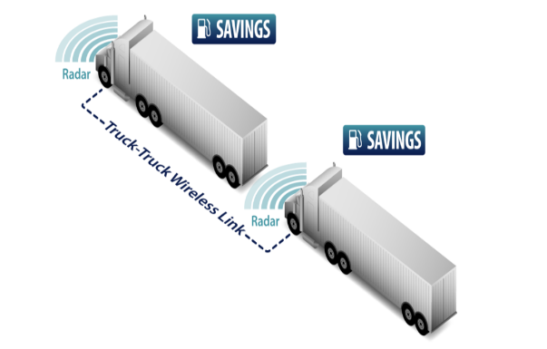
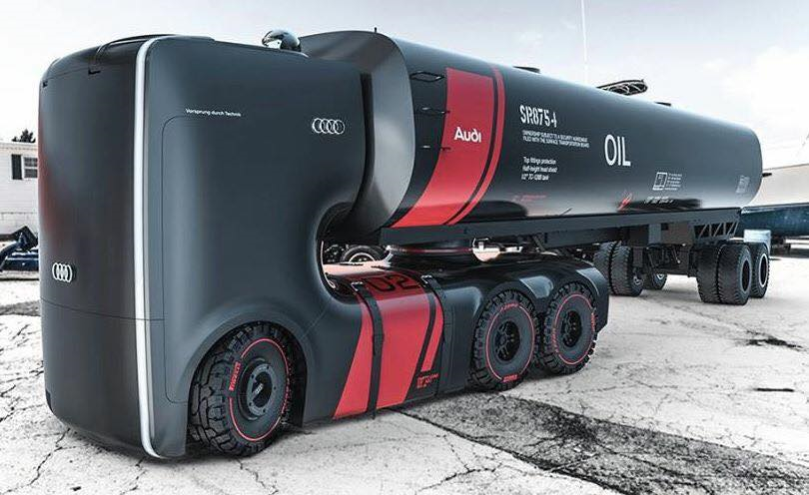
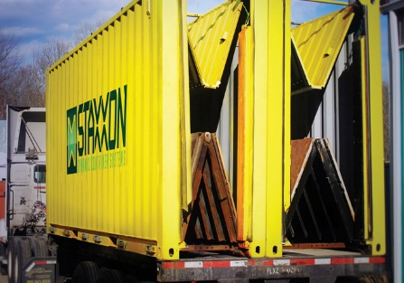
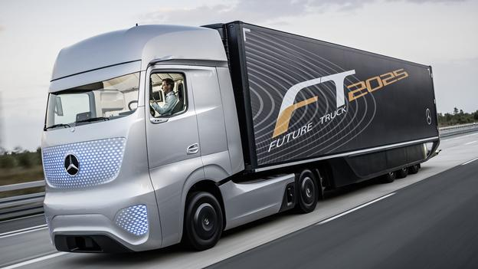
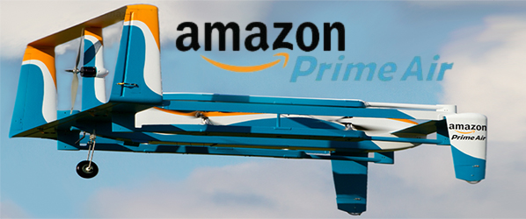
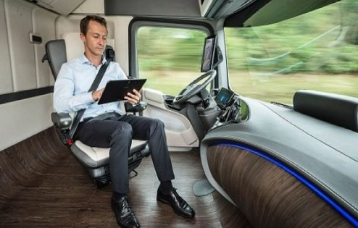
Technology and Trends in Transportation
Driver Monitoring
Traffic Coordination
Safety Technology
Platooning
New Concept Trucking
Vertically Folding Shipping Containers
Driverless Trucks
Drone Delivery
Platooning

Slide 57
Logistics Management Software Applications
Warehouse Management Systems (WMS)
Track and control the flow of goods from receiving dock to outbound shipment. New technologies, such as RFID tags, facilitate tracking.
Transportation Management Systems (TMS)
Used to select the best mix of transportation services and pricing.
Global Trade Management Systems (GTM)
Provides global visibility, standardization, and documentation to comply with international trade regulations.

Slide 58
Supply Chain
Management
Reverse Logistics

Slide 59
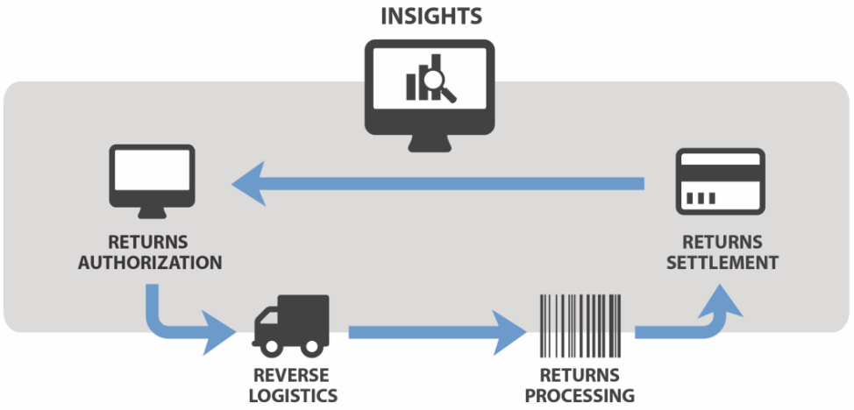

Reverse Logistics (also known as Returns Management)
Reverse logistics involves the process of moving a product from the point of customer receipt back to the point of origin to recapture value or ensure proper disposal.
Backwards flow of goods from customers in the supply chain
Not a new
Problem
(3,768 years ago)
“Reverse logistics is all about damage control and making the process as customer-friendly as possible”
Lou Cerny, VP, Sedlak Management Consultants

Slide 60
Five R’s of Reverse Logistics
Returns - Customers return products for a number of reasons. An item may be defective, damaged, seasonal, fail to meet expectations, or be excess inventory.
Recalls - Recalls are more complex than basic returns because they typically involve a product defect or potential hazard and may be subject to government regulations, liability concerns or reporting requirements.
Repairs - Not all products that are returned are disposed. Manufacturers may identify the failure and repair, refurbish or remanufacture the product to like-new condition and return it to stock, or harvest various components for re-use.
Repackaging – 95% of returned products are because customers are dissatisfied with them not because there are defective. These products are typically repackaged and returned to inventory for restock or resale.
Recycling - When products reach the ends of their useful lives and must be scrapped, companies must find safe, cost-effective and environmentally friendly ways to dispose of them. Companies can reduce costs and minimize waste.

Slide 61

Reverse Logistics (continued)
Reverse logistics cost 4 – 5 times as much as forward logistics and requires on average 12 times as many processing steps.
Often viewed as:
An “unwanted” supply chain activity. Many companies outsource this activity to a 3PL
A cost of doing business
A quality or regulatory compliance issue

Slide 62

Poor Reverse Logistics Can Hurt A Company
Problems include:
Inability of information systems to handle returns
Lack of worker training in reverse logistics procedures
Little or no identification on returned packages
Need for adequate inspection and testing of returns
Danger of placing returned products back into sales stocks
Can affect the entire supply chain financially
Can have a large impact on how a consumer views a product or brand, potentially impacting future sales.
Retail returns = 6% to 10% of sales

Slide 63

Return of Unsold Goods
In some industries, goods are distributed to downstream members in the supply chain with the understanding that the goods may be returned for credit if they are not sold e.g., newspapers, magazines, even pharmaceuticals.
This acts as an incentive for downstream members to carry more stock, because the risk of obsolescence is borne by the upstream supply chain partner.
The risk is that the downstream member in the supply chain might exploit the situation by ordering more stock than is required and returning large volumes.

Slide 64

Green Reverse Logistics Programs
Can have a positive impact on the environment though activities such as recycling, reusing materials and products, or refurbishing unused products.
These programs can reduce environmental impact on landfills and deal with dangerous contaminants.
Example: Unused pharmaceutical product returned to the pharmacy rather than “flushing it down the toilet” which ultimately causes the drug to end up in the water supply.

Slide 65

End of Chapter Quiz

